Slide 1
RefWorks
Notes:
Trixie, I’m going to let RefWorks define itself. This information is straight from their website. Do you understand that RefWorks allows you to “import” your references from various electronic sources, usually databases. It also formats your references in APA style formatting. But this explanation didn’t tell you that RefWorks allows you to attach any of your full text articles to the reference.

Slide 2
RefWorks
collects your citations into
one electronic location

Slide 3
RefWorks
allows full text of article to be
attached to its citation

Slide 4
RefWorks
provides “folders” for each
research paper

Slide 5
RefWorks
creates in-text citing
formats Works Cited page

Slide 6
RefWorks
Best of all, RefWorks can store your own research paper
Once saved, it’s in the cloud
No more worries about losing your jump drive
No more worries about having your laptop stolen
Notes:
Trixie, I’m going to let RefWorks define itself. This information is straight from their website. Do you understand that RefWorks allows you to “import” your references from various electronic sources, usually databases. It also formats your references in APA style formatting. But this explanation didn’t tell you that RefWorks allows you to attach any of your full text articles to the reference.

Slide 7
RefWorks
Best Practice: use Mozilla Firefox in both:
Databases
RefWorks
Notes:
Trixie, I’m going to let RefWorks define itself. This information is straight from their website. Do you understand that RefWorks allows you to “import” your references from various electronic sources, usually databases. It also formats your references in APA style formatting. But this explanation didn’t tell you that RefWorks allows you to attach any of your full text articles to the reference.

Slide 8
RefWorks
To Login to RefWorks:
Go to research.udmercy.edu
Click Articles, Journals, + Databases
Notes:
Trixie, I’m going to let RefWorks define itself. This information is straight from their website. Do you understand that RefWorks allows you to “import” your references from various electronic sources, usually databases. It also formats your references in APA style formatting. But this explanation didn’t tell you that RefWorks allows you to attach any of your full text articles to the reference. Go LIVE!!!!!!!!!!!!!!!!!!!!!!!!!!!!!!!!!!!!!!!!!!!!!!!

Slide 9
RefWorks
Click “R”
Click RefWorks
RefWorks
RefWorks is a web-based database and bibliography creator. RefWorks users can import references from online databases and use these references in writing their papers and automatically format the bibliography and paper in seconds. When signing up for your individual account, you will need to use your UDM email address and
Notes:
Trixie, I’m going to let RefWorks define itself. This information is straight from their website. Do you understand that RefWorks allows you to “import” your references from various electronic sources, usually databases. It also formats your references in APA style formatting. But this explanation didn’t tell you that RefWorks allows you to attach any of your full text articles to the reference.

Slide 10
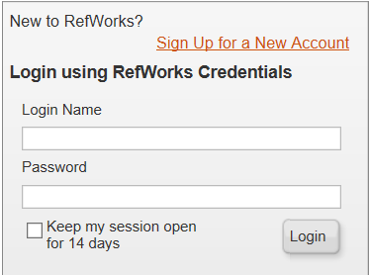
RefWorks
New users must create an account in RefWorks
Click: Sign Up for a New Account
Follow directions

Slide 11
RefWorks
For remote access to RefWorks:
Use the University’s GroupCode to complete login:
RWUDetroitMer
It’s case sensitive!
Notes:
An easy way to remember the GroupCode: Capital RW = RefWorks Capital UD = University of Detroit Lower case = fill in the rest of Detroit –etroit Capital M = Mercy
Lower case = “er” We ran out of characters for the “cy”
Trixie, I’m going to let RefWorks define itself. This information is straight from their website. Do you understand that RefWorks allows you to “import” your references from various electronic sources, usually databases. It also formats your references in APA style formatting. But this explanation didn’t tell you that RefWorks allows you to attach any of your full text articles to the reference.

Slide 12
Tutorials in RefWorks
For more help using RefWorks
Click Help

Slide 13
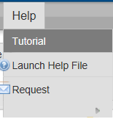
Tutorials in RefWorks
Click Tutorial
Watch YouTube videos

Slide 14
Creating Folders in RefWorks
Create a folder to place all your citations
Click New Folder:
Notes:
Trixie, I’m going to let RefWorks define itself. This information is straight from their website. Do you understand that RefWorks allows you to “import” your references from various electronic sources, usually databases. It also formats your references in APA style formatting. But this explanation didn’t tell you that RefWorks allows you to attach any of your full text articles to the reference.

Slide 15
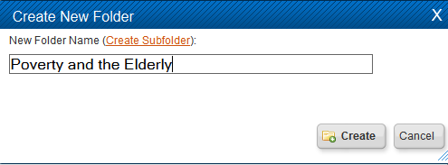
Creating Folders in RefWorks
Give folder a name: name of class, instructor, or topic of paper
Click Create
Notes:
Trixie, I’m going to let RefWorks define itself. This information is straight from their website. Do you understand that RefWorks allows you to “import” your references from various electronic sources, usually databases. It also formats your references in APA style formatting. But this explanation didn’t tell you that RefWorks allows you to attach any of your full text articles to the reference.

Slide 16
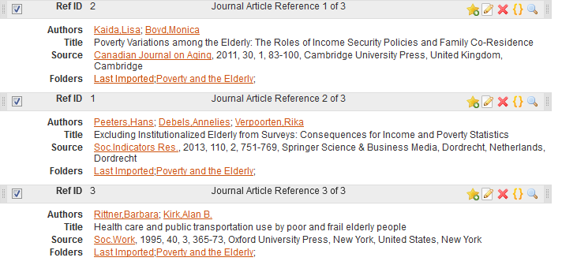
Imported Citations
Put check mark by each citation to place in newly created folder
Notes:
Trixie, I’m going to let RefWorks define itself. This information is straight from their website. Do you understand that RefWorks allows you to “import” your references from various electronic sources, usually databases. It also formats your references in APA style formatting. But this explanation didn’t tell you that RefWorks allows you to attach any of your full text articles to the reference.

Slide 17
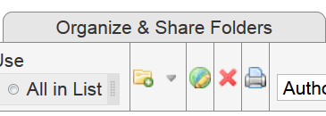
Putting Citations in Folder
Click yellow folder under
Organize & Share Folders
Notes:
Trixie, I’m going to let RefWorks define itself. This information is straight from their website. Do you understand that RefWorks allows you to “import” your references from various electronic sources, usually databases. It also formats your references in APA style formatting. But this explanation didn’t tell you that RefWorks allows you to attach any of your full text articles to the reference.

Slide 18
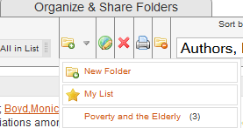
Putting Citations in Folder
You should now see Poverty and the Elderly (3):
All three references are now in that folder
Notes:
Trixie, I’m going to let RefWorks define itself. This information is straight from their website. Do you understand that RefWorks allows you to “import” your references from various electronic sources, usually databases. It also formats your references in APA style formatting. But this explanation didn’t tell you that RefWorks allows you to attach any of your full text articles to the reference.

Slide 19
Exporting from a Database
Worth Repeating:
Best Practice: use Mozilla Firefox in both:
Databases
RefWorks
Notes:
As mentioned in the RefWorks Intro video, make sure you are using Mozilla Firefox when accessing both the databases and RefWorks.

Slide 20
Exporting from a Database
Topic:
Poverty
among the
Elderly
Notes:
I have already searched the Proquest Sociology Database for articles on poverty in the elderly. For the sake of this project, I am going to select the first three articles to export to RefWorks. For each article to export, put a check mark in the box attached to the citation. I will click 1, 2, 3. Scroll back up, click Export slash Save. Click RefWorks. Scroll down, click Continue. If you do not have RefWorks open, you will be given a prompt to do so. Click View Last Imported Folder. And there are the three citations I imported from the database ProQuest Sociology. To give you an idea how to find the export feature, I will quickly run through several other databases.

Slide 21
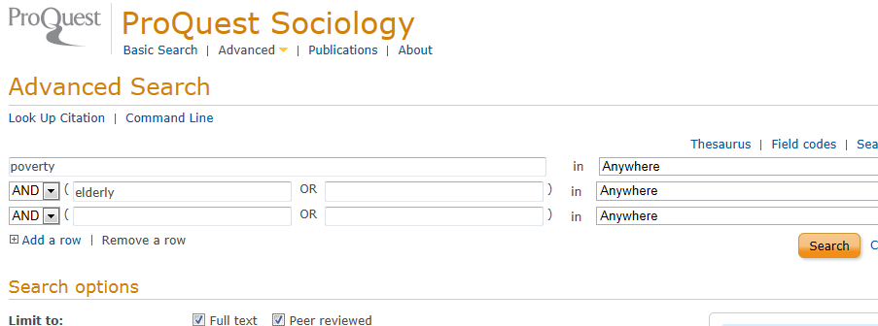
Exporting from a Database
On ProQuest Sociology Advanced Search Screen:
First search box, type poverty
Second search box, type elderly
Limit to: Full text and Peer reviewed
Notes:
Welcome to the REfWorks tutorials. Hi, I’m Sue Homant, a Reference Librarian at the University of Detroit Mercy McNichols Campus. According to its website, RefWorks is designed to help researchers easily gather, manage, store and share all types of information including citations, as well as generate in-text references and a works cited bibliography.

Slide 22
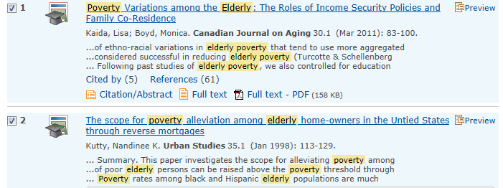
Exporting from a Database
Put check mark in box before each citation to export
Notes:
Welcome to the REfWorks tutorials. Hi, I’m Sue Homant, a Reference Librarian at the University of Detroit Mercy McNichols Campus. According to its website, RefWorks is designed to help researchers easily gather, manage, store and share all types of information including citations, as well as generate in-text references and a works cited bibliography. In this video, you will learn how to export a citation from a database into RefWorks.

Slide 23
Exporting from a Database
Click Export/Save
Notes:
Welcome to the REfWorks tutorials. Hi, I’m Sue Homant, a Reference Librarian at the University of Detroit Mercy McNichols Campus. According to its website, RefWorks is designed to help researchers easily gather, manage, store and share all types of information including citations, as well as generate in-text references and a works cited bibliography. In this video, you will learn how to export a citation from a database into RefWorks.

Slide 24
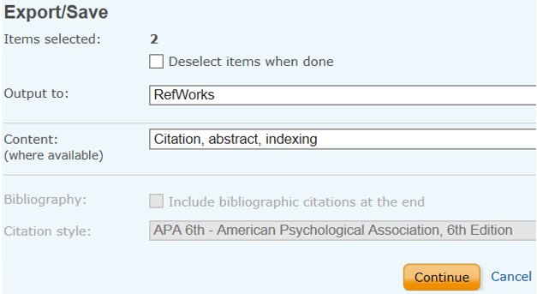
Exporting from a Database
Change Output to RefWorks
Click Continue
Notes:
Welcome to the REfWorks tutorials. Hi, I’m Sue Homant, a Reference Librarian at the University of Detroit Mercy McNichols Campus. According to its website, RefWorks is designed to help researchers easily gather, manage, store and share all types of information including citations, as well as generate in-text references and a works cited bibliography. In this video, you will learn how to export a citation from a database into RefWorks.

Slide 25
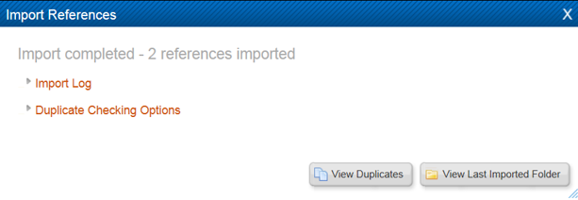
Exporting from a Database
RefWorks places imported citations in:
View Last Imported Folder
Notes:
Welcome to the REfWorks tutorials. Hi, I’m Sue Homant, a Reference Librarian at the University of Detroit Mercy McNichols Campus. According to its website, RefWorks is designed to help researchers easily gather, manage, store and share all types of information including citations, as well as generate in-text references and a works cited bibliography. In this video, you will learn how to export a citation from a database into RefWorks.

Slide 26
Exporting from a Database
Viola! The citations are added to your RefWorks account
Notes:
Welcome to the REfWorks tutorials. Hi, I’m Sue Homant, a Reference Librarian at the University of Detroit Mercy McNichols Campus. According to its website, RefWorks is designed to help researchers easily gather, manage, store and share all types of information including citations, as well as generate in-text references and a works cited bibliography. In this video, you will learn how to export a citation from a database into RefWorks.

Slide 27
Attaching a Full Text Article
RefWorks allows you to attach the full text of an article to its citation
First, save article to jump drive or computer desktop
Notes:
First you must have the article either on a jump drive or on your computer’s desktop. Go live!!!!!!!!!!!!!!!!!!!!!!!!!!!!!!!!!!!!

Slide 28
Attaching a Full Text Article
In RefWorks:
Click paper and pencil icon on citation’s menu bar
Notes:
In RefWorks, click on the paper and pencil icon on the citation’s menu bar.

Slide 29
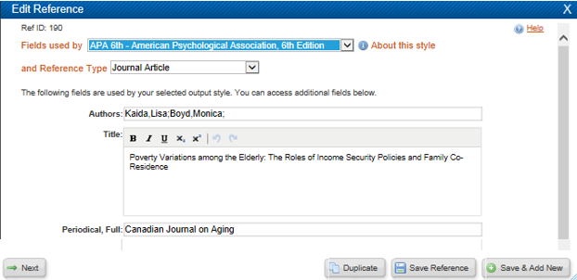
Attaching a Full Text Article
This screen now appears:
Notes:
This screen appear.

Slide 30
Attaching a Full Text Article
Scroll down
Click Browse
Notes:
Scroll down, click Browse.

Slide 31
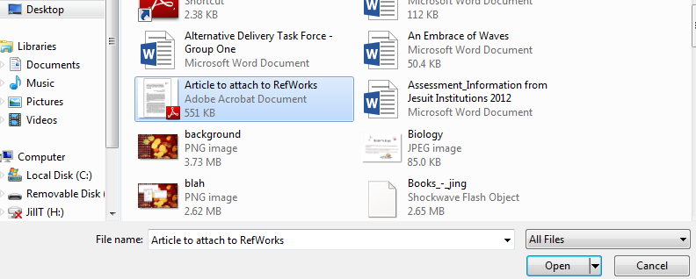
Attaching a Full Text Article
Click saved article
Click Open
Notes:
Click the saved article, click open

Slide 32
Attaching a Full Text Article
Click Save Reference
Notes:
Click Save Reference

Slide 33
Attaching a Full Text Article
You should now see:
a paperclip next to menu bar, and
Adobe symbol at Attachments
Full text of article is now attached to its citation
Notes:
You should now see: a paperclip next to the menu bar above the citation and, if you are in Full View, the Adobe symbol appears in the Attachment field. Please proceed to the other RefWorks tutorials to learn how to “export” a citation from a database to RefWorks, where to find the RefWorks YouTube videos, or how to format your paper easily, and more.

Slide 34
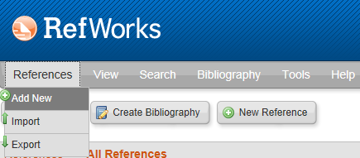
Attaching Your Research Paper
To attach your research paper or research paper draft:
Create citation
Click references
Click add new
Notes:
Click Save Reference

Slide 35
Attaching Your Research Paper
Type your name as Author
Type name of paper as Title
Repeat directions for attaching an article
Notes:
Click Save Reference

Slide 36
Creating a Bibliography
Switch from “Standard View” to “One line/Cite View”
Notes:
Click Save Reference

Slide 37
Creating a Bibliography
Your references now look like this:
Click the two curly brackets to right of title
Citation Viewer will open in new window
Notes:
Click Save Reference

Slide 38
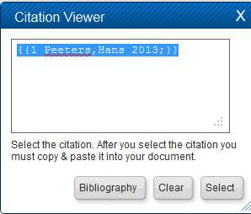
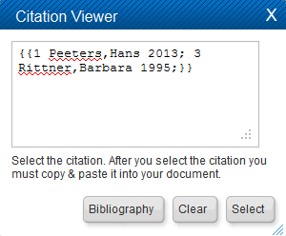
Creating a Bibliography
Citation Viewer opens in new window
To cite multiple citations, add additional references while Citation Viewer is open
Click Select
Copy text in Citation Viewer box
Press “Clear” button
Notes:
Click Save Reference

Slide 39
Creating a Bibliography
Paste text into paper where you are citing
Continue writing paper, pasting in RefWorks citation placeholders
When finished, save and close your MS Word document
Notes:
Click Save Reference

Slide 40
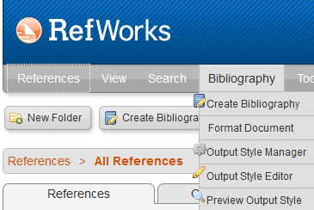
Creating a Bibliography
Click Bibliography
Click Format Document
Notes:
Click Save Reference

Slide 41
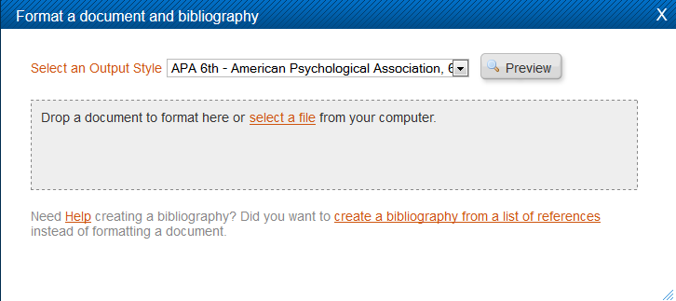
Creating a Bibliography
Select Output Style
RefWorks has multiple styles
I have chosen APA 6th ed.
Notes:
Click Save Reference

Slide 42
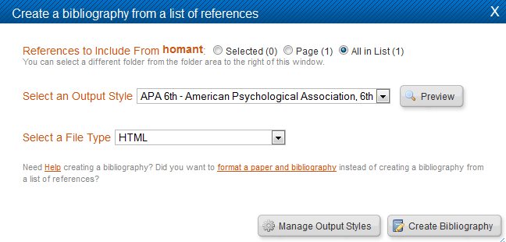
Changing Output Style
Click Manage Output Styles
Select Output Style from pull down menu
Notes:
Click Save Reference

Slide 43
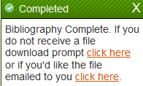
Creating a Bibliography
Click select a file
Select research paper from your saved documents
Click click here (green box, lower right)
Notes:
Click Save Reference

Slide 44
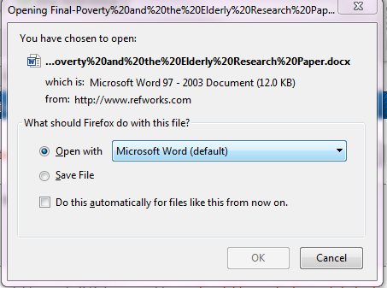
Creating a Bibliography
After you click the click here prompt,
this screen appears:
Click OK
Notes:
Click Save Reference

Slide 45
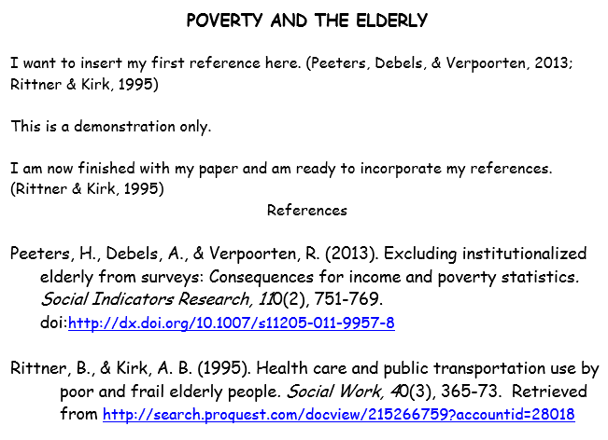
Creating a Bibliography
Viola! The completed paper perfectly formatted:
Notes:
Click Save Reference

Slide 46
Creating a Bibliography
IMPORTANT NOTE:
Do NOT assume all references are correctly formatted
For example, proper nouns within a title may not be capitalized—
YOU must do so [united states = United States]
Consult Publication Manual of the American Psychological Association, 6th ed. if necessary
Notes:
Click Save Reference

Slide 47
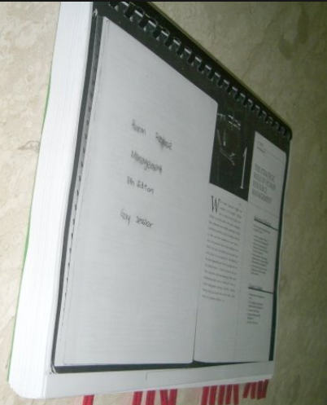
Final Paper
RefWorks created a formatted, final document with bibliography in citation style you selected
Save with a different name
A
Notes:
Click Save Reference

